Slide 1



Noida Institute of Engineering and Technology, Greater Noida
Wireless Systems & Standards
Unit: 5
Wireless Communication (AOE 0772)
Mr. Rishi Singhal
EN
Department
B. Tech 7th Sem (4th year)

Slide 2
WIRELESS COMMUNICATION
Content
Course Contents / Syllabus
UNIT-I |  | Introduction of Wireless Communication | 8 Hours
History and evolution of mobile radio systems, General Model of Wireless Communication Link, Types of mobile wireless services/systems-Cellular, WLL, Paging, Satellite Systems, Future trends in personal wireless systems.
UNIT-II | Cellular Concepts and System Design Fundamentals |  | 8 Hours
Cellular Infrastructure, Cellular System Components, Antennas for Cellular Systems, Operation of Cellular Systems, frequency reuse, channel assignment, handoff strategies, Interference and system capacity.
UNIT-III | Mobile Radio Propagation Models |  | 8 Hours
Radio wave propagation issues in personal wireless systems, Propagation models, Channel Noise and Losses, Fading in Land Mobile Systems, Multipath Fading, Fading Effects on Signal and Frequency, Shadowing; Wireless Channel Modeling: AWGN Channel, Rayleigh Channel,
UNIT- IV | Equalization, Diversity Techniques & Multiple Access Techniques |  | 8 Hours
Equalization, Rake receiver concepts, Diversity Techniques, Linear predictive coders and channel coding. Multiplexing and Multiple Access: FDMA, TDMA, CDMA, OFDMA, Multiple Access for Radio Packet Systems: Pure ALOHA, Slotted ALOHA, CSMA and their versions; Packet and Pooling Reservation Based Multiple Access Schemes.
UNIT-V | Wireless Systems & Standards |  | 8 Hours
GSM system for mobile Telecommunication, General Packet Radio Service, Edge Technology; CDMA 2000, IMT 2000 and UMTS, Long Term Evolution (LTE), Introduction to Mobile Adhoc Networks, Li-Fi Communication, Ultra-Wideband Communication, Mobile data networks, Introduction to 4G, 5G and concept of NGN.

Slide 3
WIRELESS COMMUNICATION
Content
Course Outcomes: After completion of this course students will be able to
CO 1 | Explain with various generations of mobile communications. | K1, K2
CO 2 | Explain concept of cellular communication. | K2
CO 3 | Describe the basics of wireless communication. | K2
CO 4 | Explain and differentiate contention free and contention based multiple access techniques. | K2,K4
CO 5 | Explain Various modern wireless technologies. | K2

Slide 4
WIRELESS COMMUNICATION
Content
Text Books:
T.S. Rappaport, “Wireless Communication-Principles and practice”, Pearson Publications, Second Edition.
2. Upena Dalal, “Wireless Communication and Networks”, Oxford Press Publications.
3. T L Singal ,“Wireless Communications ”, McGraw Hill Publications.
Reference Books:
1. Andrea Goldsmith, “Wireless Communications”, Cambridge University Press.
2. S. Haykin & M. Moher, “Modern wireless communication”, Pearson, 2005.
NPTEL/ YouTube/ Faculty Video Link:
Unit 1 | https://youtu.be/JCGMP37-2EA
Unit 2 | https://youtu.be/f2wlHL1Sok8 https://youtu.be/0PWILK-hqbQ
Unit 3 | https://youtu.be/SFcRtZ30rqs https://youtu.be/BKf2mN9W6Nk https://youtu.be/tePZhxRLsjE
Unit 4 | https://youtu.be/GLmF3YB0pQU https://youtu.be/QHqZwBoTJRY
Unit 5 | https://youtu.be/t3FVP5wuG4g https://youtu.be/ixY0Cau4mBM

Slide 5
Content
GSM system for mobile Telecommunication
General Packet Radio Service, Edge Technology
CDMA 2000
IMT 2000 and UMTS
Long Term Evolution (LTE)
Introduction to Mobile Adhoc Networks
Li-Fi Communication
Ultra-Wideband Communication
Mobile data networks
Introduction to 4G
5G and concept of NGN.

Slide 6
Objective of Unit
To make students familiar with the fundamentals of mobile communication systems.
To make students familiar with the fundamentals of GSM system for mobile Telecommunication, General Packet Radio Service, Edge Technology.

Slide 7
Course Outcome
Familiarize with various generations of mobile communications.
Understand the concept of cellular communication.
Understand the channel modeling of wireless communication.
Understand the various spread spectrum modulation, diversity combining and equalization techniques.
Gain knowledge of IS-95 CDMA and GSM mobile communication standard, its architecture, logical channels, advantages and limitations.
Understand the different multiple access techniques of wireless mobile communication.

Slide 8
CO-PO and PSO Mapping
Mapping of Course Outcomes and Program Outcomes:
S. No. | Course Outcome | PO1 | PO2 | PO3 | PO4 | PO5 | PO6 | PO7 | PO8 | PO9 | PO10 | PO11 | PO12
1 | REC-085.1 | 2 | 2 | 1 | 1 | 2 | 2 | 2 | 2 | 2 | 2 | 1 | 3
2 | REC-085.2 | 2 | 2 | 2 | 2 | 1 | 2 | 2 | 2 | 2 | 3 | 1 | 2
3 | REC-085.3 | 3 | 1 | 2 | 1 | 2 | 2 | 1 | 1 | 2 | 3 | 2 | 2
4 | REC-085.4 | 3 | 1 | 1 | 1 | 3 | 3 | 2 | 1 | 1 | 3 | 1 | 2
5 | REC-085.5 | 2 | 1 | 2 | 2 | 3 | 3 | 2 | 1 | 2 | 3 | 2 | 2
6 | REC-085.6 | 3 | 2 | 2 | 2 | 2 | 3 | 2 | 1 | 2 | 3 | 1 | 2

Slide 9
CO-PO and PSO Mapping
Mapping of Program Specific Outcomes and Course Outcomes:
S.No | Course Outcome | PSO1 | PSO2 | PSO3
1 | REC-085.1 | 3 | 2 | 1
2 | REC-085.2 | 3 | 3 | 1
3 | REC-085.3 | 3 | 3 | 1
4 | REC-085.4 | 2 | 2 | 1
5 | REC-085.5 | 3 | 3 | 1
6 | REC-085.6 | 3 | 3 | 1
 | Average | 2.83 | 2.66 | 1

Slide 10
Prerequisite and recap
Basic knowledge of analog and digital communication.

Slide 11
GSM system for mobile Telecommunication
GSM stands for Global System for Mobile Communications. It's a widely used standard for cellular networks, primarily for voice communication but also for data transfer. Developed in the 1980s, GSM has become the foundation for many modern mobile networks worldwide.
Key features of GSM include:
Digital Technology: GSM digitizes and compresses data, allowing more efficient use of the mobile network.
Compatibility: GSM enables roaming between different networks, allowing users to travel internationally and still use their mobile devices.
Security: GSM has built-in encryption to secure calls and data transmissions, ensuring privacy and reducing the risk of eavesdropping.
SIM Cards: GSM introduced the use of SIM (Subscriber Identity Module) cards, which store subscriber data and facilitate easy switching between devices.
Multiple Services: It supports not only voice calls but also text messaging (SMS) and later versions allowed for multimedia messaging (MMS) and internet access.
GSM has evolved over time, with various generations like 2G, 3G, and 4G building upon its foundations. 2G GSM introduced digital encryption, 3G improved data speeds and capabilities, and 4G LTE brought faster internet access.

Slide 12
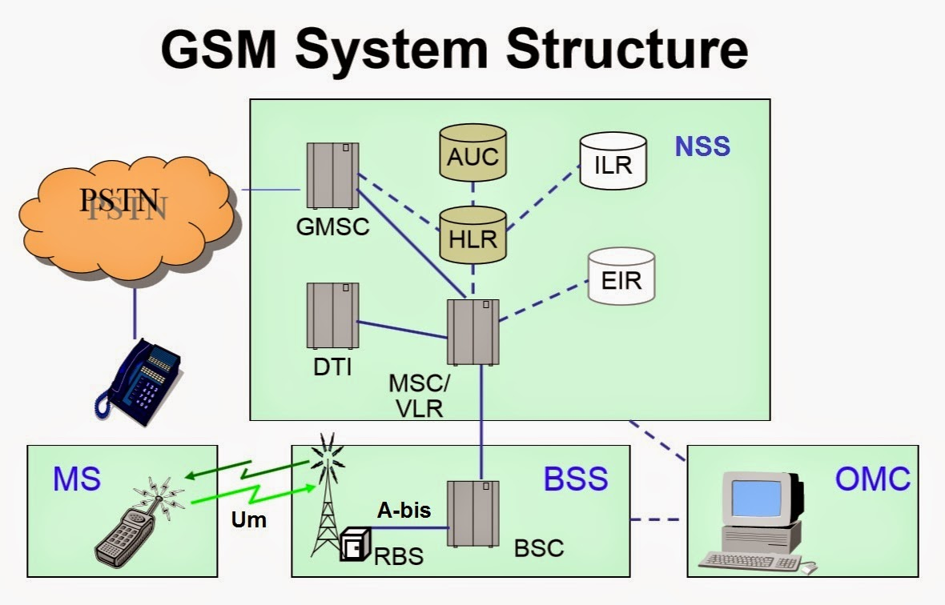
GSM system for mobile Telecommunication

Slide 13
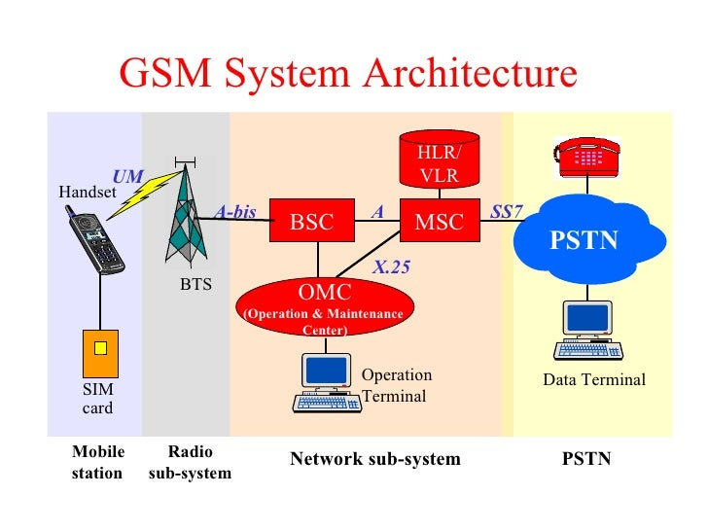
GSM system for mobile Telecommunication

Slide 14
General Packet Radio Service, Edge Technology
General Packet Radio Service (GPRS) and Enhanced Data rates for GSM Evolution (EDGE) are enhancements to the GSM mobile communication system, designed to enable data transmission and internet connectivity over cellular networks.
General Packet Radio Service (GPRS):
Introduction: GPRS, introduced as an upgrade to GSM, enabled the delivery of data packets over the existing GSM infrastructure.
Packet Switching: Unlike traditional circuit-switched connections used for voice calls, GPRS operates on packet-switched technology. It divides data into small packets, allowing more efficient use of network resources.
Always-On Connectivity: GPRS provided an 'always-on' connection, meaning users didn’t have to establish a dial-up connection for data transfer, enabling quicker access to internet services, emails, and other data-related applications.
Enhanced Capacity: GPRS increased data transfer rates compared to traditional GSM, allowing for speeds up to several times faster, although still relatively slow compared to later technologies.

Slide 15
General Packet Radio Service, Edge Technology
Enhanced data rates for GSM Evolution (EDGE):
Evolution of GPRS: EDGE was an enhancement of the GPRS technology, providing even higher data transfer speeds.
Data Transmission Speed: EDGE improved upon GPRS by significantly increasing data rates, offering speeds closer to broadband.
Modulation Technique: EDGE used more advanced modulation techniques to achieve faster data transmission within the existing GSM infrastructure, improving spectral efficiency.
Backward Compatibility: EDGE was backward compatible with existing GSM/GPRS networks, allowing a smooth transition to faster data speeds without requiring a complete overhaul of network infrastructure.

Slide 16
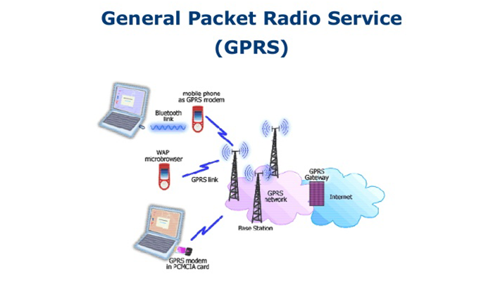
General Packet Radio Service, Edge Technology

Slide 17
General Packet Radio Service, Edge Technology
Combined Impact:
Data Connectivity: GPRS and EDGE technologies were crucial in popularizing mobile internet access by making it more accessible and faster on GSM-based networks.
Transition to 3G and Beyond: GPRS and EDGE acted as stepping stones toward more advanced mobile technologies like 3G and 4G by demonstrating the feasibility and demand for higher data speeds and enhanced capabilities over cellular networks.
Both GPRS and EDGE played pivotal roles in transforming mobile communication by enabling data transmission and laying the groundwork for the mobile internet revolution, which further expanded with subsequent generations of mobile technology like 3G, 4G, and beyond.

Slide 18
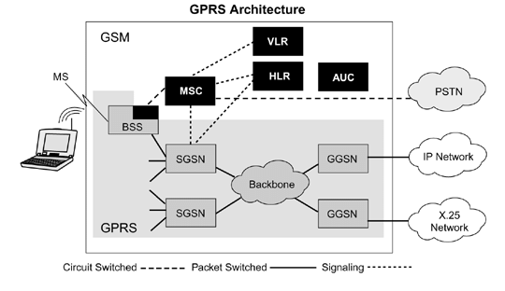
General Packet Radio Service, Edge Technology

Slide 19
CDMA2000
CDMA2000 (also known as CDMA2000 1x) is a family of 3G mobile communication standards based on Code Division Multiple Access (CDMA) technology. It was developed as an upgrade to CDMAOne (IS-95), offering higher data speeds, improved capacity, and more advanced services.
Evolution and Standards:
Introduction: CDMA2000 was developed by the 3rd Generation Partnership Project 2 (3GPP2) as part of the ITU (International Telecommunication Union) IMT-2000 framework, providing high-speed data and multimedia services over cellular networks.
Multiple Standards: There are several CDMA2000 standards, including CDMA2000 1x, CDMA2000 1xEV-DO (Evolution-Data Optimized), and CDMA2000 1xEV-DV (Evolution-Data and Voice).
Backward Compatibility: CDMA2000 networks were designed to be backward compatible with existing CDMA networks, facilitating a smoother transition and allowing users with older devices to still access the network.

Slide 20
CDMA2000
CDMA2000 1x:
Data and Voice: CDMA2000 1x primarily focused on providing higher data speeds compared to its predecessor, allowing for data rates of up to 144 kbps, significantly faster than the original CDMAOne technology.
Efficiency: It improved spectral efficiency, allowing for more users to be supported on the same bandwidth.
Applications: CDMA2000 1x enabled services such as internet browsing, multimedia messaging (MMS), and basic video calling, expanding the capabilities of CDMA networks.
CDMA2000 1xEV-DO and 1xEV-DV:
Evolution to Higher Speeds: CDMA2000 1xEV-DO (Evolution-Data Optimized) and 1xEV-DV (Evolution-Data and Voice) further advanced the technology, offering higher data rates suitable for broadband applications.
Data-Optimized Services: 1xEV-DO was specifically optimized for data services, offering faster speeds suitable for applications like video streaming, online gaming, and faster downloads.

Slide 21
CDMA2000
Impact and Legacy:
Data Revolution: CDMA2000, especially its EV-DO variants, played a significant role in advancing mobile data services, providing faster speeds and enabling a wide range of data-intensive applications.
Global Adoption: CDMA2000 networks were deployed in various countries, particularly in North America and parts of Asia, contributing to the global proliferation of 3G mobile technologies.
While CDMA2000 networks were prevalent and successful for a period, the industry gradually shifted toward the GSM-based technologies and subsequent generations like 4G LTE and 5G, which became more globally dominant due to their widespread adoption and higher data speeds.

Slide 22
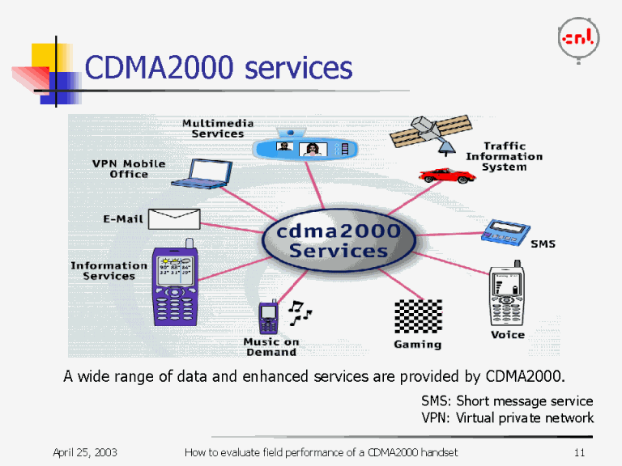
CDMA2000

Slide 23
Long Term Evolution (LTE)
Long Term Evolution (LTE) is a standard for wireless broadband communication for mobile devices and data terminals. It represents a significant advancement in mobile network technology and is often referred to as a 4G technology, offering faster speeds and improved performance compared to its predecessors.
Key Features of LTE:
High Data Rates: LTE significantly increases data transfer speeds, providing theoretical peak download rates of several hundred megabits per second (Mbps) and upload rates of up to 50 Mbps.
Low Latency: It reduces network latency, enabling quicker response times and supporting applications that require real-time interaction, such as online gaming and video conferencing.

Slide 24
CDMA2000
3. Spectrum Efficiency: LTE optimizes the use of available radio spectrum more efficiently than earlier technologies, allowing for more users and higher data rates within the same frequency bands.
4. IP-Based Network: LTE is based on an all-IP network architecture, streamlining data transmission and enabling seamless integration with other internet-based services.
5. Backward Compatibility: LTE networks are designed to be backward compatible with existing 2G and 3G networks, ensuring a smooth transition for users and devices.

Slide 25
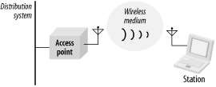
Elements of a WI-FI Network
Access Point (AP) - The AP is a wireless LAN transceiver or “base station” that can connect one or many wireless devices simultaneously to the Internet.
Wi-Fi cards - They accept the wireless signal and relay information. They can be internal and external.(e.g PCMCIA Card for Laptop and PCI Card for Desktop PC)
Safeguards - Firewalls and anti-virus software protect networks from uninvited users and keep information secure.

Slide 26
Advantages
Freedom – You can work from any location that you can get a signal.
Setup Cost – No cabling required.
Flexibility – Quick and easy to setup in temp or permanent space.
Scalable – Can be expanded with growth.
Mobile Access – Can access the network on the move.

Slide 27
Disadvantages
Speed – Slower than cable.
Range – Affected by various medium.
Travels best through open space.
Reduced by walls, glass, water, etc
Security – Greater exposure to risks.
Unauthorized access.
Compromising data.
Denial of service.

Slide 28
Ultra-Wideband (UWB)
Ultra-Wideband (UWB) communication is a wireless technology that uses a broad spectrum of frequencies to transmit data over short distances with high precision. It operates across a wide range of frequencies, enabling high data rates and precise location awareness.
Key Aspects of Ultra-Wideband Communication:
Wide Spectrum: UWB technology utilizes a large portion of the radio spectrum, spanning from very low frequencies to extremely high frequencies. It operates across multiple GHz of bandwidth, enabling high-speed data transmission.
Low Power and High Precision: UWB transmits data using very low power levels spread over a wide frequency band. It allows for precise time and location-based information, making it suitable for applications requiring accuracy, like positioning and tracking.

Slide 29
Ultra-Wideband (UWB)
3. Short-Range Communication: UWB is optimized for short-range communication, typically within a few meters, but it can achieve high data rates within that limited range.
4. High Data Rates: Due to its wide frequency range, UWB can achieve very high data rates, making it suitable for applications demanding high-bandwidth connections like multimedia streaming and file transfers.
5. Low Interference: UWB's low power and wideband transmission reduce the likelihood of interference with other wireless systems operating in the same frequency bands.
Applications of Ultra-Wideband:
Precision Location Tracking: UWB's ability to provide accurate location and distance measurements is utilized in applications like indoor positioning systems, asset tracking, and real-time location services.
Short-Range Wireless Connectivity: UWB enables fast and secure data transfer between devices, making it useful for wireless USB connections, wireless display connections, and wireless sensor networks.
Automotive and IoT Applications: In the automotive industry, UWB is used for keyless entry systems, vehicle-to-vehicle communication, and enhancing safety features. In the IoT space, it supports various smart devices and applications requiring high data rates and low latency.
Healthcare and Wearable Technology: UWB can facilitate precise tracking in healthcare settings, such as tracking medical equipment or monitoring patient movement. It's also used in wearable devices for accurate fitness tracking and vital sign monitoring.

Slide 30
Introduction to Mobile Adhoc Networks
Mobile Ad hoc Networks (MANETs) are self-configuring, infrastructure-less networks formed by a collection of mobile devices or nodes that communicate with each other without relying on any centralized infrastructure or fixed access points. These networks dynamically form and adapt as nodes move, join, or leave the network.
Key Characteristics of MANETs:
Dynamic Topology: Nodes in MANETs can move freely, leading to a constantly changing network topology. This dynamic nature requires adaptive routing protocols to maintain connectivity.
Self-Organization: MANETs are self-organizing, meaning nodes collaborate to establish and maintain network connectivity without any pre-existing infrastructure. Each node acts as both a host and a router.
Limited Resources: Mobile devices in MANETs often have limited battery power, processing capabilities, and bandwidth. Optimization of resource utilization is crucial for efficient network operation.
Adaptive Routing: Routing protocols in MANETs need to adapt to the changing topology and network conditions, considering factors like node mobility, link quality, and energy levels.
Applications: MANETs find applications in scenarios such as military operations, disaster recovery, emergency response, vehicular networks, IoT communication, and scenarios where deploying a fixed infrastructure is challenging or impossible.

Slide 31
Introduction to Mobile Adhoc Networks
Challenges in MANETs:
Routing: Due to the dynamic nature of the network, designing efficient and reliable routing protocols is a significant challenge. Protocols need to handle frequent topology changes, node mobility, and limited resources effectively.
Security: Ensuring secure communication in MANETs is challenging due to the lack of a centralized authority. Nodes may be vulnerable to various security threats like eavesdropping, node impersonation, and denial-of-service attacks.
Quality of Service (QoS): Maintaining QoS parameters such as reliability, latency, and throughput in a dynamic and resource-constrained environment is complex and requires specialized protocols.
Energy Efficiency: Managing node energy efficiently is crucial in MANETs. Techniques to conserve energy, optimize routing paths, and reduce overhead are essential to prolong network lifetime.

Slide 32
Introduction to Mobile Adhoc Networks
Routing Protocols in MANETs:
Proactive Protocols: These maintain routing information for all nodes in the network, ensuring immediate connectivity but often leading to higher overhead.
Reactive Protocols: These establish routes only when needed, reducing overhead but potentially causing delays when initiating connections.
Hybrid Protocols: Combining aspects of proactive and reactive protocols, these aim to strike a balance between immediate connectivity and reduced overhead.
MANETs offer flexible, resilient, and adaptable communication in scenarios where traditional infrastructure-based networks may be impractical. However, their dynamic nature poses several challenges that need to be addressed to ensure efficient and reliable communication among mobile nodes.

Slide 33
Topic Objective
Name of Topic | Objective of Topic | Mapping with CO
Wi- Max | Students will learn Wi- Max and its specifications. | CO6

Slide 34
Wi Max
WIMAX stands for Worldwide Interoperability for Microwave Access.
WiMAX was formed in April 2001, in anticipation of the publication of the original IEEE 802.16 specifications.
WiMAX refers to broadband wireless networks that are based on the IEEE 802.16 standard, which ensures compatibility and interoperability between broadband wireless access equipment.
It is based on Wireless MAN technology.
A wireless technology optimized for the delivery of IP centric services over a wide area.
A scalable wireless platform for constructing alternative and complementary broadband networks.

Slide 35
WiMAX - Building Blocks
A WiMAX system consists of two major parts −
A WiMAX base station. A WiMAX base station consists of indoor electronics and a WiMAX tower similar in concept to a cell-phone tower.
A WiMAX base station can provide coverage to a very large area up to a radius of 6 miles.
Any wireless device within the coverage area would be able to access the Internet.
The WiMAX base stations would use the MAC layer defined in the standard, a common interface that makes the networks interoperable and would allocate uplink and downlink bandwidth to subscribers according to their needs, on an essentially real-time basis.
Each base station provides wireless coverage over an area called a cell. Theoretically, the maximum radius of a cell is 50 km or 30 miles however, practical considerations limit it to about 10 km or 6 miles.

Slide 36
WiMAX - Building Blocks
A WiMAX receiver: A WiMAX receiver may have a separate antenna or could be a stand-alone box or a PCMCIA card sitting in your laptop or computer or any other device. This is also referred as customer premise equipment (CPE).
WiMAX base station is similar to accessing a wireless access point in a WiFi network, but the coverage is greater.

Slide 37
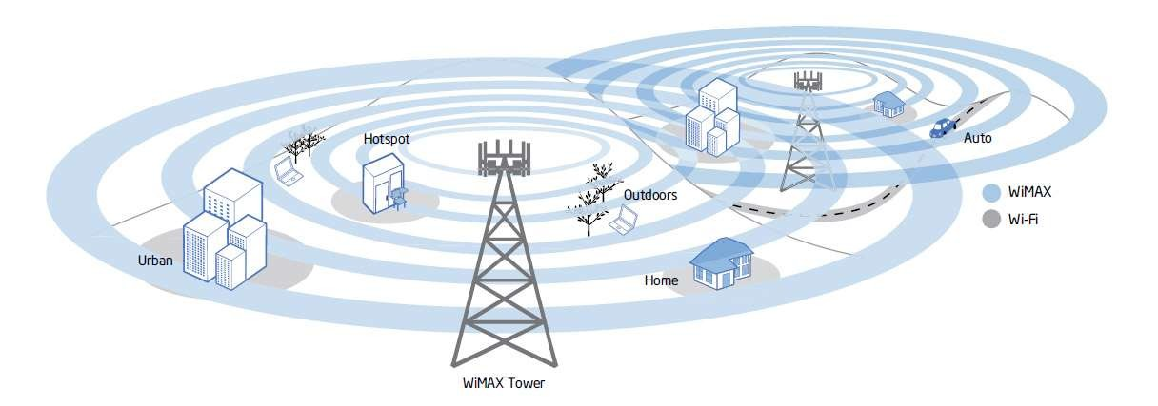
Wi- Fi vs Wi- Max

Slide 38
Specifications of Wi Max
Range - 30-mile (50-km) radius from base station
Speed - 70 megabits per second
Frequency bands - 2 to 11 GHz and 10 to 66 GHz (licensed and unlicensed bands)
Benefits of Wi Max
Speed
Faster than broadband service.
Wireless
Not having to lay cables reduces cost.
Easier to extend to suburban and rural areas.
Broad Coverage
Much wider coverage than WiFi hotspots.

Slide 39
Topic Objective
Name of Topic | Objective of Topic | Mapping with CO
Li- Fi | Students will learn about Li- Fi | CO6

Slide 40
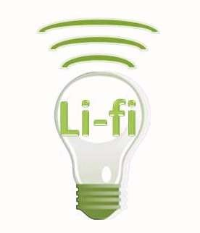
Li-Fi
Li-Fi can be thought of as a light-based Wi-Fi. That is, it uses light instead of radio waves to transmit information.
And instead of Wi-Fi modems, Li- Fi would use transceiver-fitted LED lamps that can light a room as well as transmit and receive information.
LI-FI is transmission of data through illumination ,ie sending data through a LED light bulb that varies in intensity faster than human eye can follow
LI FI- LIGHT FIDEALITY
`

Slide 41
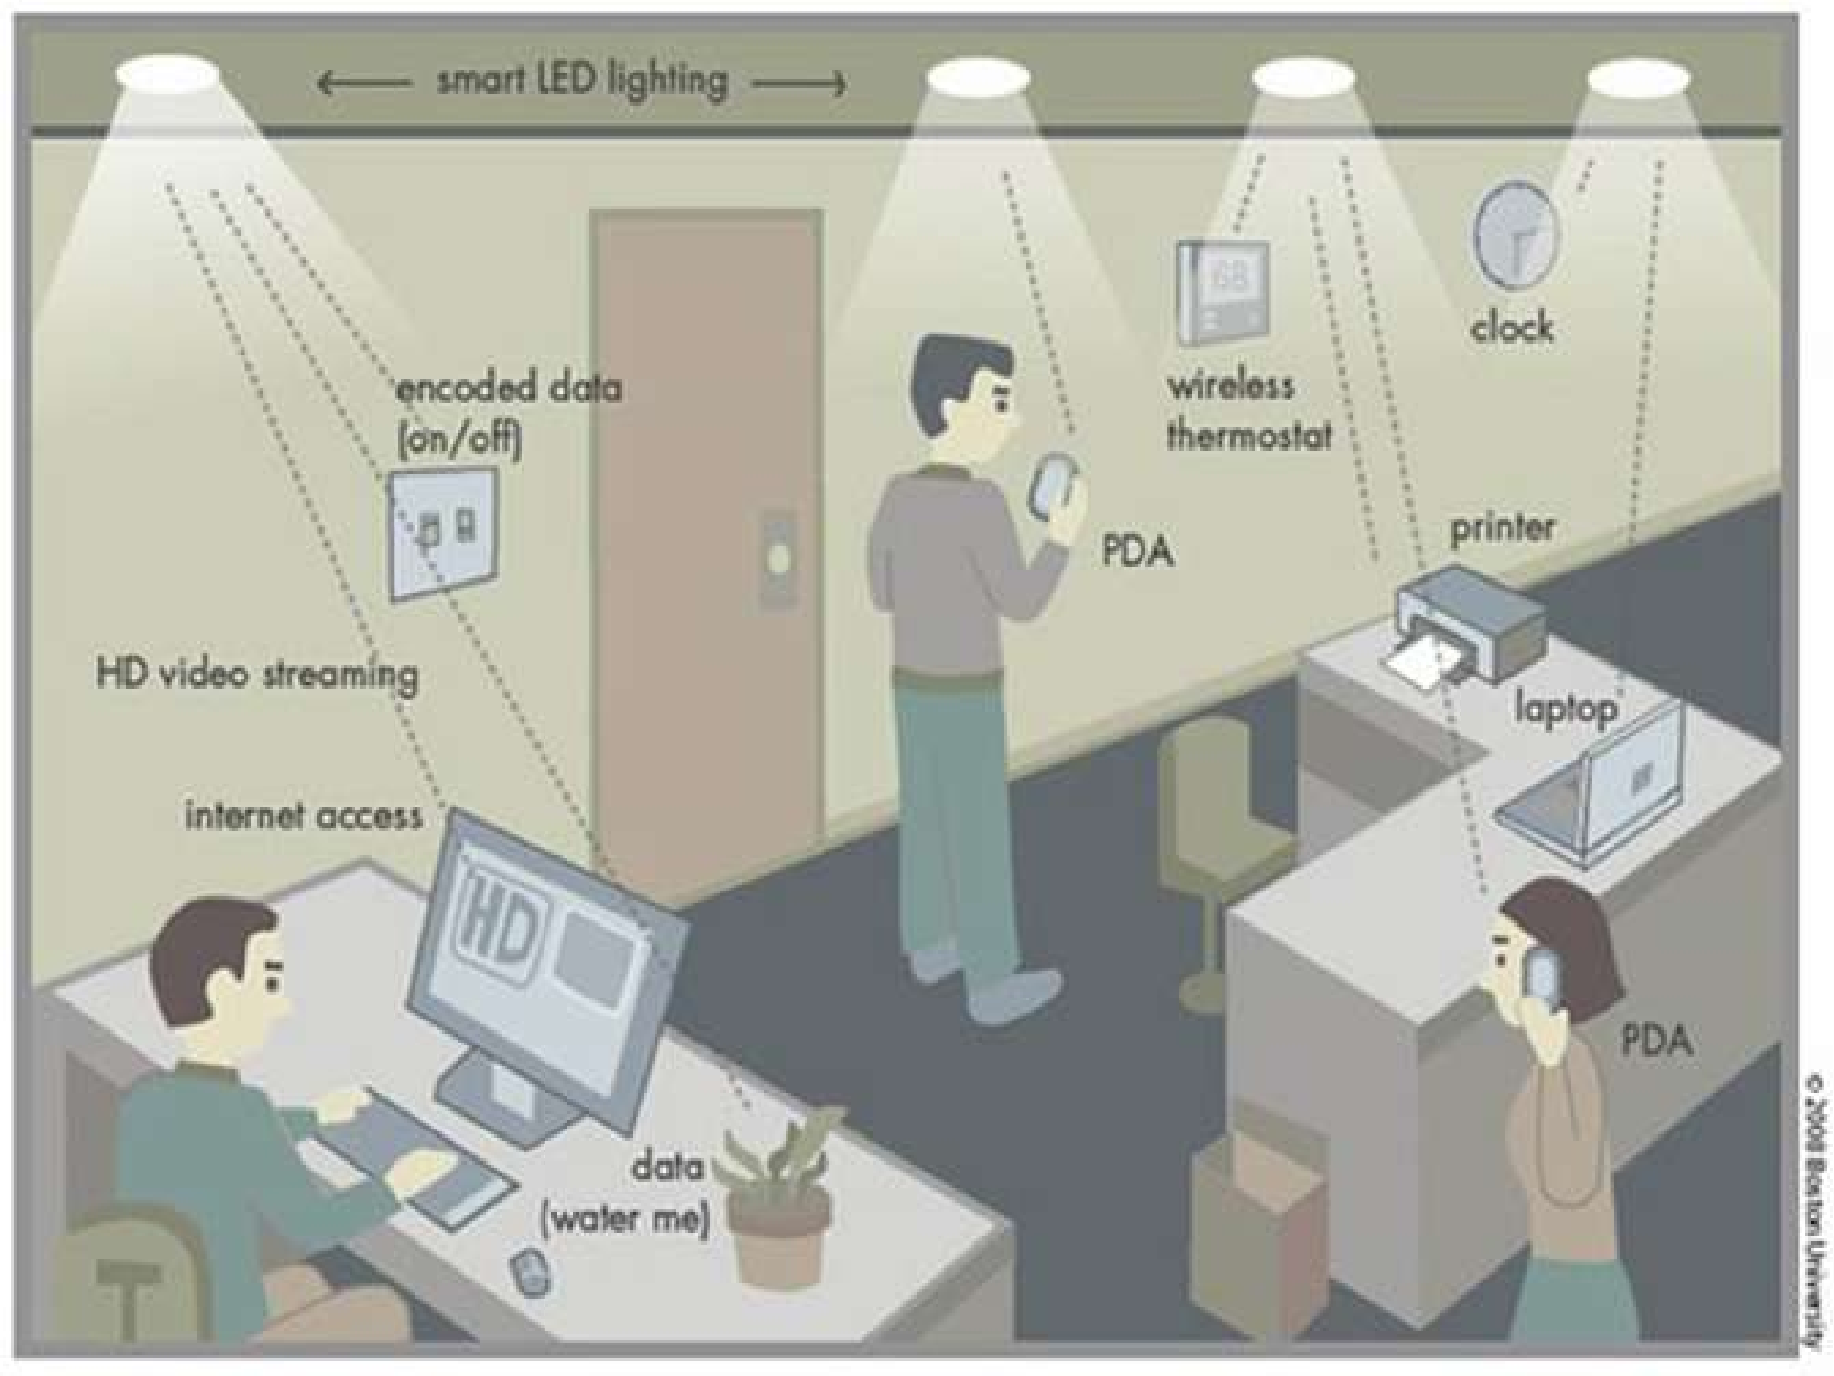
Li- Fi

Slide 42
How LI-FI Works ?
operational procedure is very simple, if the led is on, you transmit a digital 1, if its off you transmit a 0. The LEDs can be switched on and off very quickly, which gives nice opportunities for transmitting data. Hence all that us required is some LEDS and a controller that code data into those LEDs. We have to just vary the rate at which the LED’s flicker depending upon the data we want to encode.
Thus every light source will works as a hub for data transmission

Slide 43
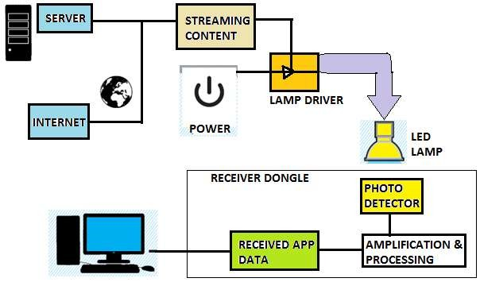
How LI-FI Works ?

Slide 44
Topic Objective
Name of Topic | Objective of Topic | Mapping with CO
Cellular communication systems | Students will learn about Cellular communication systems | CO1, CO6

Slide 45
Cellular communication systems
First Generation (1G)
Second Generation (2G)
2.5 Communication Systems
Third Generation (3G) communication systems
Fourth Generation (4G) systems

Slide 46
1G TECHNOLOGY
1G refers to the first generation of wireless telephone technology, mobile telecommunications which was first introduced in 1980s and completed in early 1990s.
It's Speed was upto 2.4kbps.
1G network use Analog Signal.
AMPS was first launched in USA in 1G mobile systems.

Slide 47
2G TECHNOLOGY
2G technology refers to the 2nd generation which is based on GSM.
It was launched in Finland in the year 1991.
2G network use digital signals.
It’s data speed was upto 64kbps
Supports voice as well as data.
2.5G is a technology between the second (2G) and third (3G) generation of mobile telephony.
2.5G is General Packet Radio Service (GPRS), which is evolution from GSM.

Slide 48
3G TECHNOLOGY
3G technology refer to third generation which was introduced in year 2000s.
Data Transmission speed increased from 144kbps- 2Mbps.
Features
Providing Faster Communication
Send/Receive Large Email Messages
High Speed Web / More Security

Slide 49
4G TECHNOLOGY (Anytime ,Anywhere)
4G technology refer to or short name of fourth Generation which was started from late 2000s.
Capable of providing 100Mbps – 1Gbps speed.
Features Include:
More Security
High Speed
High Capacity
Low Cost Per-bit etc.

Slide 50
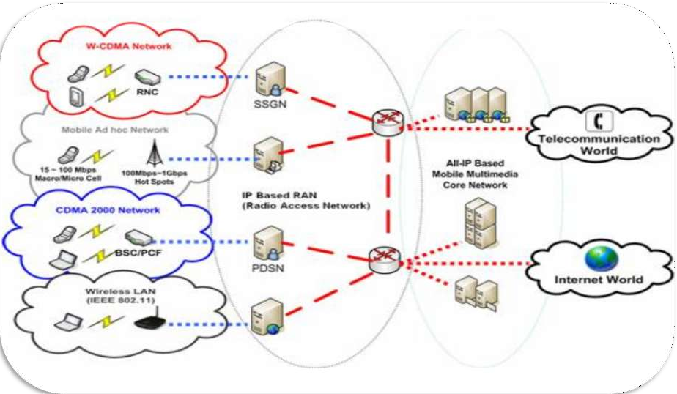
4G ARCHITECTURE

Slide 51
APPLICATIONS
4G and public safety Sensors in public vehicle
Cameras in traffic light
First responder route selection
Traffic control during disasters
M-commerce
Entertainment services
Communication services
Organizational services

Slide 52
Topic Objective
Name of Topic | Objective of Topic | Mapping with CO
IMT- 2000 | Students will learn about IMT 2000 and its standards | CO6

Slide 53
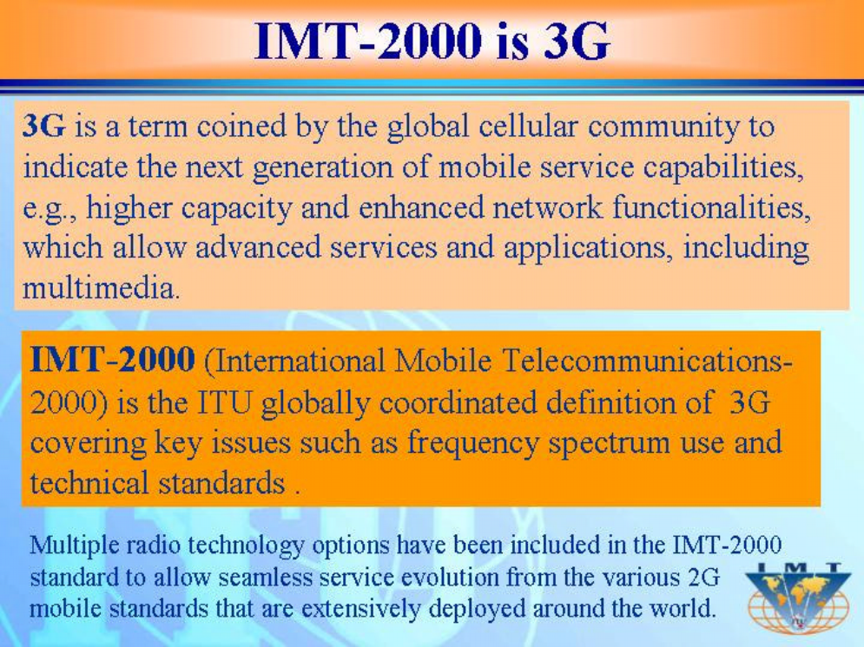
IMT-2000

Slide 54
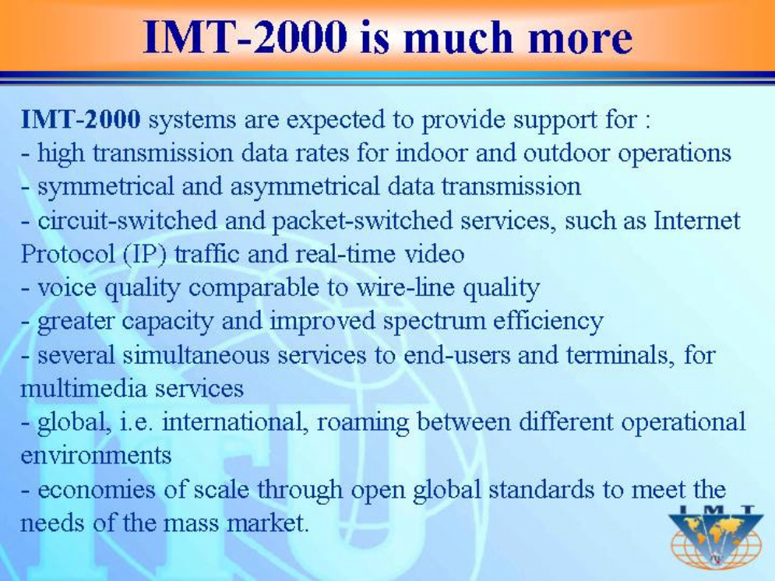

Slide 55
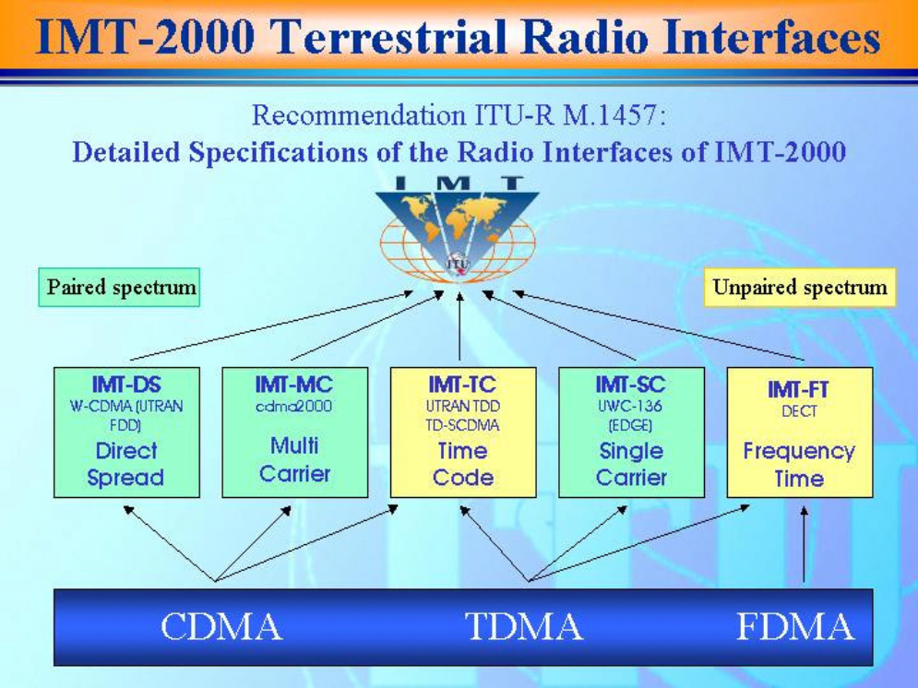
IMT- 2000 STANDARDS

Slide 56
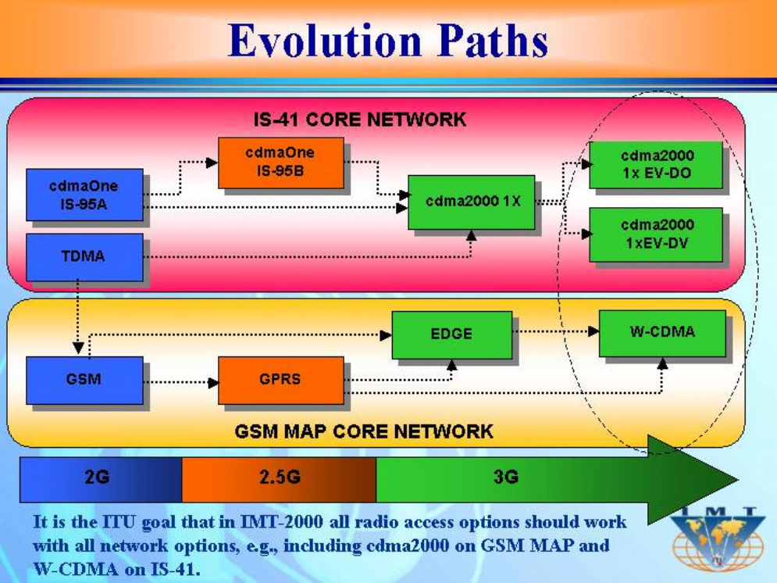
IMT- 2000 EVOLUTION

Slide 57
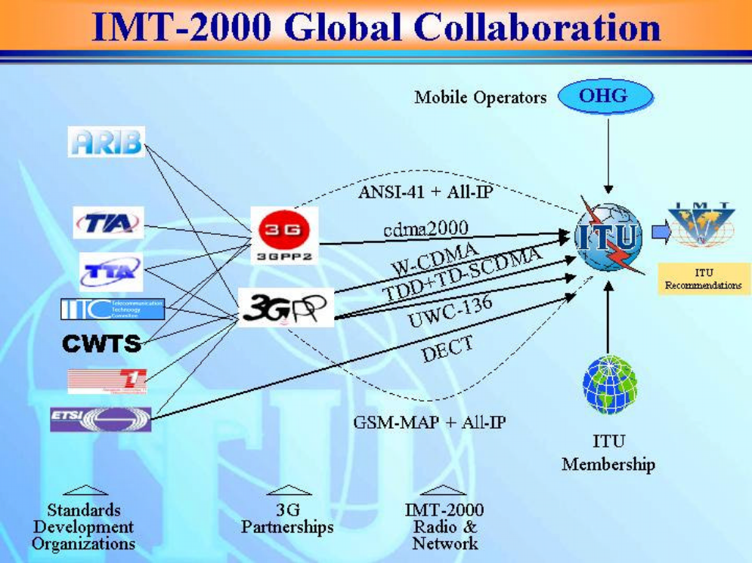
IMT COLLABORATION

Slide 58
Introduction to 4G
4G refers to the fourth generation of mobile network technology, succeeding 3G (Third Generation) networks. It represents a significant advancement in wireless communication, offering faster speeds, better performance, and enhanced capabilities compared to its predecessors.
Key Features of 4G:
High-Speed Data: 4G networks are designed to provide significantly faster data speeds compared to 3G. They aim for peak download speeds of up to 100 Mbps and upload speeds of up to 50 Mbps.
Low Latency: 4G networks reduce latency, allowing quicker response times, which is crucial for real-time applications like video calls, online gaming, and live streaming.
IP-Based Technology: 4G is based on an all-IP (Internet Protocol) network architecture, facilitating seamless integration with other IP-based services and applications.
Improved Efficiency: It optimizes the use of radio spectrum, allowing more efficient data transmission and handling more users simultaneously.
Enhanced Multimedia Support: 4G networks provide better support for high-definition video streaming, multimedia applications, and rich content services due to their higher data rates.

Slide 59
5G and concept of NGN
5G:
Fifth Generation Mobile Networks: 5G represents the latest generation of mobile network technology, succeeding 4G LTE.
Key Features:
High Speeds: 5G promises significantly faster data speeds compared to its predecessors, potentially reaching multi-gigabit-per-second speeds.
Low Latency: It aims to minimize network latency, enabling near-real-time communication and supporting applications like autonomous vehicles and remote surgery.
Massive Connectivity: 5G is designed to connect a massive number of devices simultaneously, facilitating the Internet of Things (IoT) and smart city applications.
Network Slicing: It allows the creation of multiple virtual networks on a single physical infrastructure, catering to various needs such as IoT, enterprise applications, and more.

Slide 60
5G and concept of NGN
Next-Generation Network (NGN):
Concept of Evolution: NGN refers to the evolution of telecommunications networks to create more versatile and adaptable infrastructures.
IP-Based Networks: NGN emphasizes the shift from traditional circuit-switched networks to packet-switched networks, primarily based on IP (Internet Protocol).
Integration of Services: NGN integrates various communication services (voice, data, multimedia) into a single IP-based infrastructure, enabling seamless and efficient delivery of services.
Scalability and Flexibility: NGN architectures are designed to be highly scalable, allowing for easy expansion and modification to accommodate new technologies and services.
Quality of Service (QoS): NGN enables improved QoS by providing better control and management of network resources.

Slide 61
5G and concept of NGN
Relationship Between 5G and NGN:
Synergy: 5G networks are designed to leverage NGN principles, utilizing IP-based architectures and flexible infrastructures to deliver the promised high-speed, low-latency, and high-capacity services.
Support for 5G Services: NGN's capabilities, especially in terms of IP-based networks and service integration, are crucial in supporting the diverse range of services and applications that 5G enables, such as IoT, augmented reality, and mission-critical communications.
In essence, 5G represents the latest evolution in mobile network technology, offering unprecedented speed, connectivity, and capabilities, while NGN embodies the broader concept of evolving telecommunications infrastructures towards more adaptable, IP-based, and versatile networks capable of supporting the demands of the digital age.

Slide 62
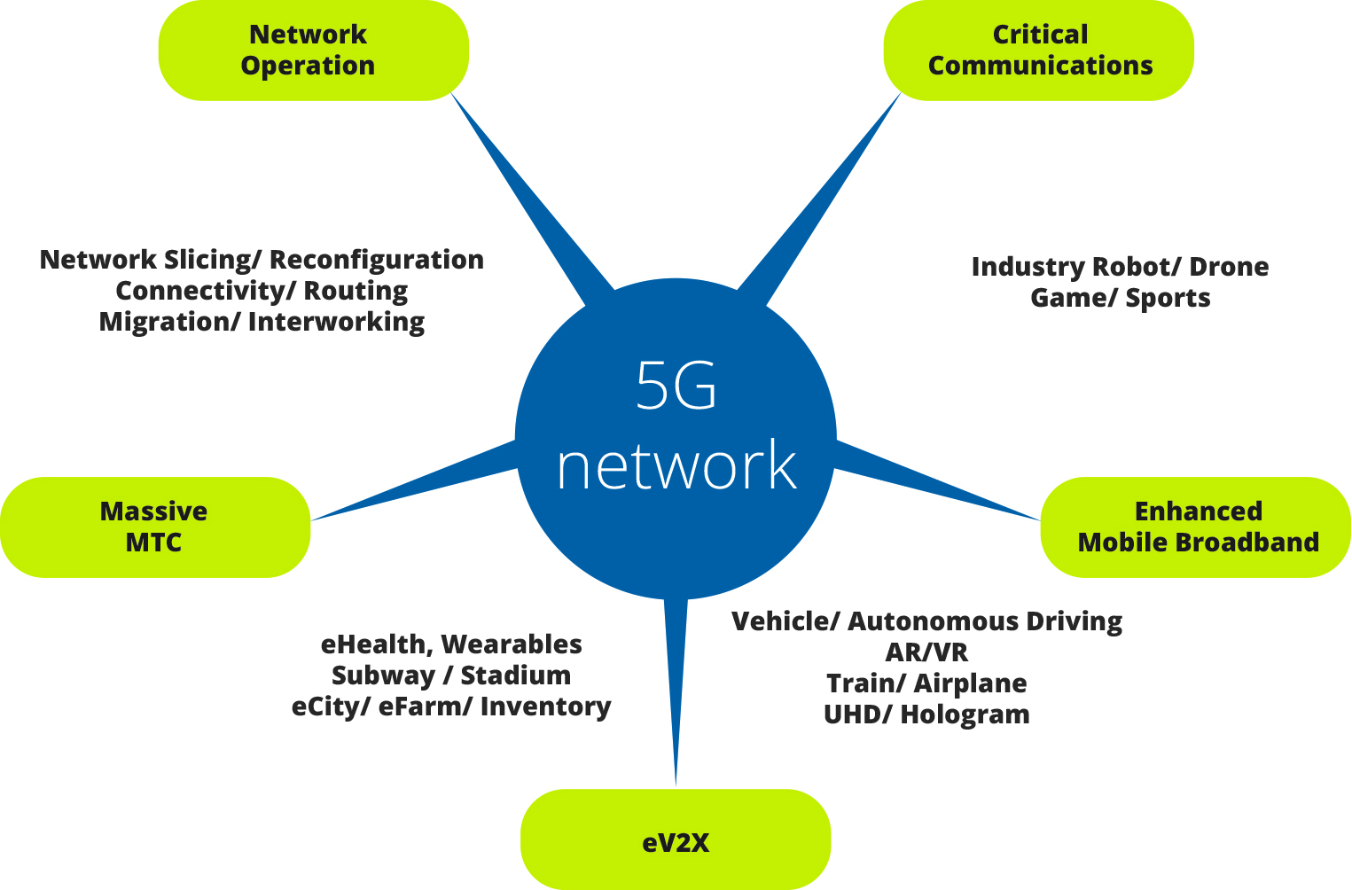
5G and concept of NGN

Slide 63
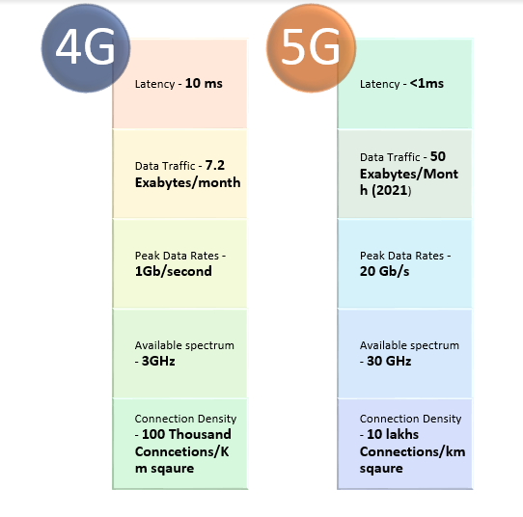
Comparision

Slide 64
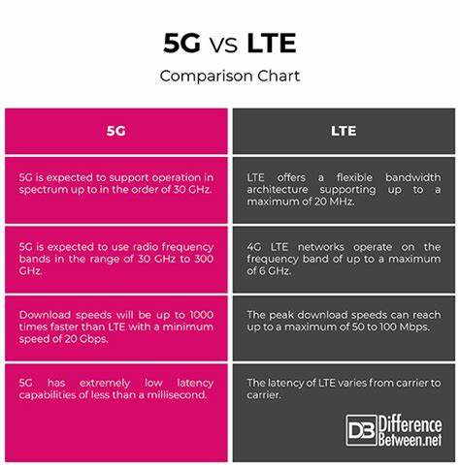
Comparision

Slide 65
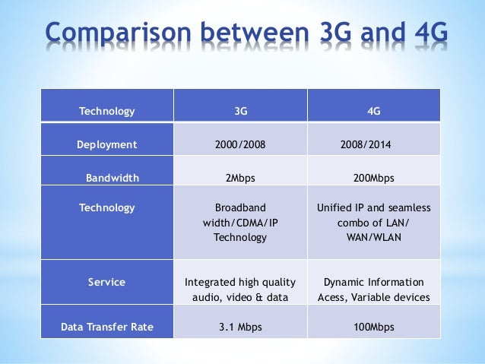
Comparision

Slide 66
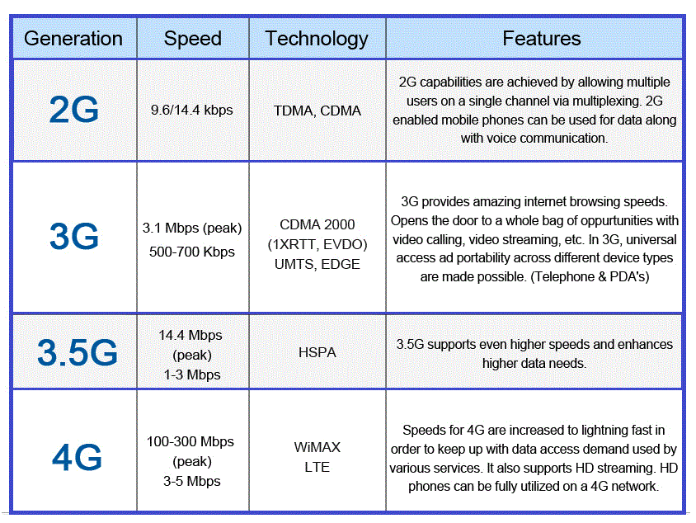
Comparision

Slide 67
Faculty Video Links, Youtube & NPTEL Video Links and Online Courses Details
https://youtu.be/LXSkpB35cjw
https://youtu.be/CI9No9Ci9Ro
https://youtu.be/WpOW0eaZuZU

Slide 68
Weekly Assignment
What are the main characteristics of IMT-2000?
Explain the 4G system and its applications.
What do you understand by mobile Ad-Hoc network (MANETs)? Why and how a proper route is required to discover in Ad-Hoc network?
Discuss a complete model of Next Generation Network system for mobile communication. How it is useful for network security?
Draw the architecture of GSM and explain each block.

Slide 69
Quiz
What is UMTS? Explain the working with reference to distributed data base and network reach-ability.
Discuss GSM traffic channels (TCH) and control channels (CCH).
Explain and discuss Ultra-Wideband Communication.
Explain CDMA 2000.
What is General Packet Radio Services?

Slide 70
MCQs
GSM System for Mobile Telecommunication:
Which technology introduced SIM cards for mobile devices?
A) 3G
B) CDMA
C) GSM
D) LTE
Answer: C) GSM
General Packet Radio Service (GPRS) and Edge Technology:
Which technology enabled 'always-on' internet connectivity over GSM networks?
A) GPRS
B) EDGE
C) LTE
D) CDMA
Answer: A) GPRS
CDMA 2000:
What is the primary advantage of CDMA 2000 technology?
A) Higher data rates
B) Better voice quality
C) Lower latency
D) Greater spectral efficiency
Answer: A) Higher data rates
Long Term Evolution (LTE):
LTE Advanced (LTE-A) technology introduced which feature to improve network capacity?
A) Carrier Aggregation
B) Enhanced voice quality
C) Reduced latency
D) Increased device compatibility
Answer: A) Carrier Aggregation

Slide 71
MCQs
Introduction to Mobile Adhoc Networks:
What is a characteristic feature of Mobile Adhoc Networks (MANETs)?
A) Static topology
B) Centralized infrastructure
C) Dependence on fixed access points
D) Dynamic topology
Answer: D) Dynamic topology
Ultra-Wideband Communication:
What is one of the primary applications of Ultra-Wideband (UWB) communication?
A) Long-range communication
B) Low data rate transmission
C) High precision location tracking
D) Low-power consumption
Answer: C) High precision location tracking
Introduction to 4G:
Which characteristic defines 4G technology compared to its predecessors?
A) Higher latency
B) Lower data speeds
C) All-IP network architecture
D) Reduced network efficiency
Answer: C) All-IP network architecture
5G and Concept of NGN:
What is the primary focus of Next-Generation Network (NGN)?
A) Enhancing mobile data speeds
B) Transitioning from IP-based networks
C) Adapting to static network topologies
D) Advancing telecommunications infrastructure
Answer: D) Advancing telecommunications infrastructure

Slide 72
MCQs
Li-Fi Communication:
Li-Fi technology primarily uses which medium for data transmission?
A) Radio waves
B) Infrared light
C) Sound waves
D) Magnetic fields
Answer: B) Infrared light
IMT 2000 and UMTS:
What does UMTS stand for in the context of mobile communication?
A) Universal Mobile Telecommunications System
B) Ultra-Modern Transmission System
C) Unifying Mobile Technologies and Services
D) Unified Messaging and Telephony System
Answer: A) Universal Mobile Telecommunications System
Mobile Data Networks:
Which technology allows mobile devices to connect to the internet through cellular networks?
A) Wi-Fi
B) Bluetooth
C) 3G
D) NFC (Near Field Communication)
Answer: C) 3G

Slide 73
MCQs
5G and Concept of NGN:
What does NGN (Next-Generation Network) emphasize in modern telecommunications?
A) Static network architectures
B) Centralized infrastructure
C) Moving away from IP-based networks
D) Advancing and adapting telecommunications infrastructure
Answer: D) Advancing and adapting telecommunications infrastructure
Ultra-Wideband Communication:
Which feature distinguishes Ultra-Wideband (UWB) communication technology?
A) Long-range transmission capabilities
B) High-power consumption
C) Low data rates
D) Utilization of a broad spectrum of frequencies
Answer: D) Utilization of a broad spectrum of frequencies
Introduction to 4G:
What is a significant advantage of 4G technology over its predecessors?
A) Higher latency
B) Lower data speeds
C) All-IP network architecture
D) Reduced network efficiency
Answer: C) All-IP network architecture

Slide 74
Expected university questions
Explain the 4G system and its applications.
What do you understand by mobile Ad-Hoc network (MANETs)? Why and how a proper route is required to discover in Ad-Hoc network?
Discuss a complete model of Next Generation Network system for mobile communication. How it is useful for network security?
Draw the architecture of GSM and explain each block.
What are the main characteristics of IMT-2000?
What is UMTS? Explain the working with reference to distributed data base and network reach-ability.
Discuss GSM traffic channels (TCH) and control channels (CCH).
Explain and discuss Ultra-Wideband Communication.
Explain CDMA 2000.
What is General Packet Radio Services?

Slide 75
Thank you

